Slide 1

Student and Parent Orientation
Grades K-8
2026-2027
Notes:
6/3/21

Slide 2

PFE Goals
Ease isolation and loneliness of the elderly by promoting connection.
For students and mentors to create intergenerational relationships and experience the blessing of service.
Support Adventist Education by awarding tuition scholarships
Legacy Video

Slide 3
PFE is for students who are:
Passionate about service
Intentional and creative with their visits/service
Committed to visiting a mentor for 1 hour weekly
A student who values Christian education

Slide 4
How it works
Find a mentor who fits the PFE profile
Complete a 1-hour visit each week
Submit reflection online/phone app during visit. Reflections are due the day of the visit.
  late reflections will be rejected
  $30 PFE scholarship awarded per visit

Slide 5
Choosing Your Mentor
Who does NOT live in a nursing home
Who can commit to 1-hour visits every week
With whom you can form a relationship, have similar interests/hobbies
Who is NOT related to you by any degree
Who is cognitively healthy (no Alzheimer’s or dementia)
Who might be lonely and is needing company
Age 55+ recommended (can be under 40 if they have a physical disability)

Slide 6
Apply for a Student Account
Go to pfe.sffcfoundation.org
Click "Student Application"
Complete the application
(you must have your mentor’s age and contact info for this step)
Once your school coordinator approves your account, you will receive an email prompting you to complete account creation by selecting a password
Follow the link in the email and choose your password
Log in

Slide 7
Schedule Your First Visit
Once your application has been approved by your Coordinator you may start your weekly visits.
  Only 1 visit is allowed each week. Visits must last a minimum of 1 hour.
In the event of a missed visit:
You can choose to miss that week of scholarship OR make up the visit
Only one make-up visit is allowed per month
Make-up visits may not occur on the same day as another visit

Slide 8
Visiting
Discuss with your mentor what activities he/she would like to do during your visit together.
Be on time, Let your mentor know ahead of time if you need to reschedule.
The ideas are endless! Work with your mentor to see what activities fit best for both of you.
Submit your reflection DURING your visit.

Slide 9

Safety
Students in grades K-8 must be supervised by a parent or legal guardian.
The supervising parent or guardian must be able to either see or hear the student throughout the visit.
Unsupervised visits may result in dismissal from the PFE program.

Slide 10
Visit Activities
Acceptable
Playing board games or sports together
Teaching your mentor about technology
Helping your mentor grocery shop or clean house
Visiting a museum together
Eating at a restaurant or picnic
Baking
Unacceptable
Watching TV/Movie
Using your phone for personal reasons
Visiting your mentor’s home while they are absent
Virtual Visits
Sabbath Visits
Visits located at the church or school
Visits at mentor’s place of employment
Group visits with other mentor student pairs

Slide 11
Reflect on Your Visit
During your visit:
Login to your PFE App or online PFE account
01
Click “Submit New Reflection”
02
Fill out the form and submit, uploading any pictures you'd like to share
03
Check for successful submission (will receive email/text)
04
Your coordinator will review, then approve or reject your reflection
  If approved, you will receive an email/text confirmation.
  If rejected, you will receive an email/text. You may edit and resubmit your reflection for this visit date if your coordinator allows. (within 4 days of original submission date)
For tech issues you must notify your coordinator immediately.
Delayed notification will not qualify for scholarship.

Slide 12
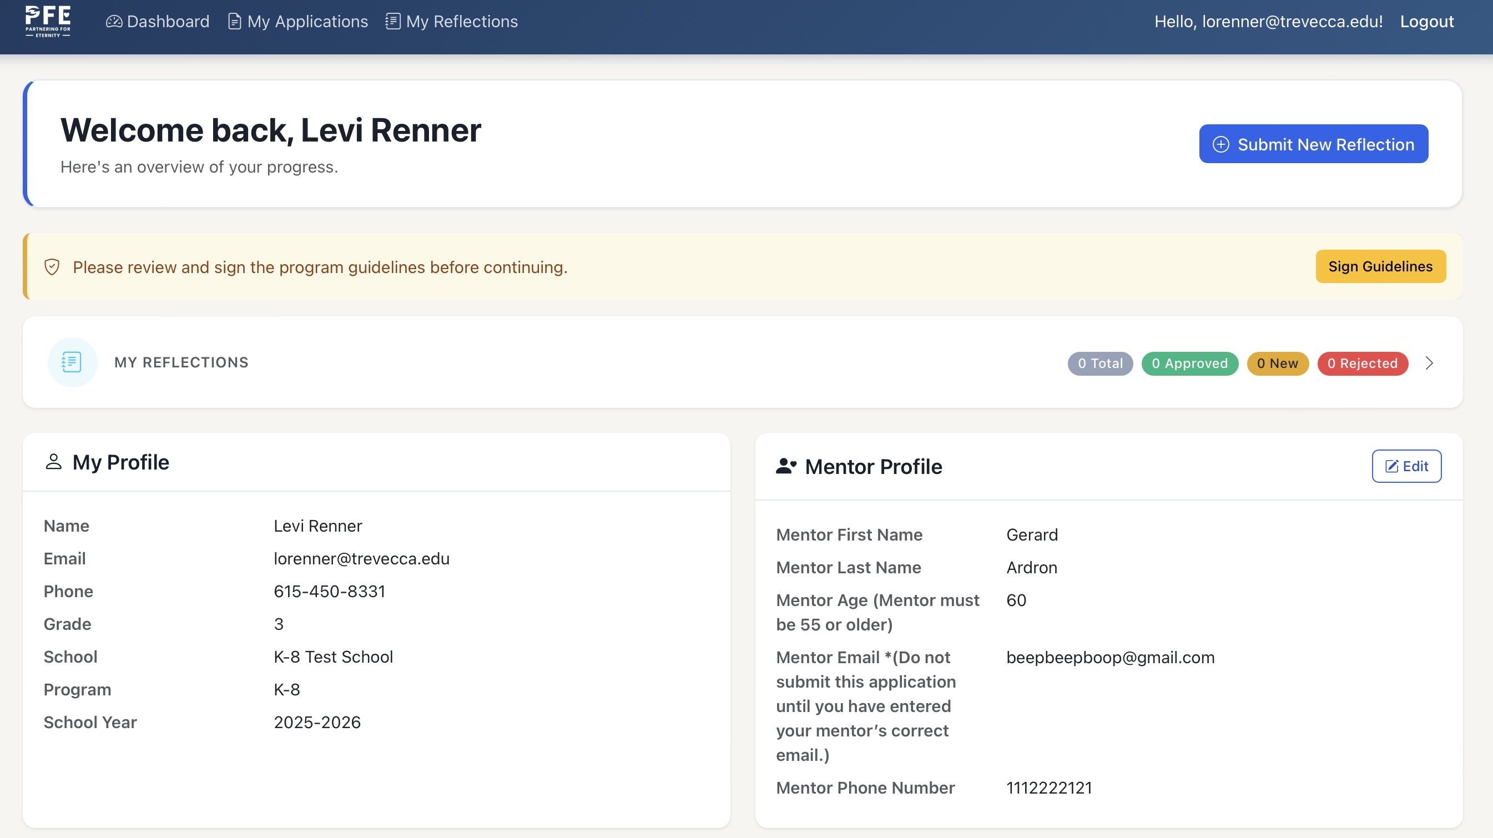
PFE Student Dashboard

Slide 13
Surveys and Agreements
You will need to Agree to Guidelines and complete a Student Survey before you can submit your first reflection. (popup screens)
  To complete your agreements/survey
    Login to your PFE Dashboard Online (not the PFE App)
    Click “My Reflections” in the toolbar at the top of the page
    Click “Submit New Reflection”
    A popup will open for Agreements/Survey.
  You can now submit your first reflection online or via the PFE App

Slide 14
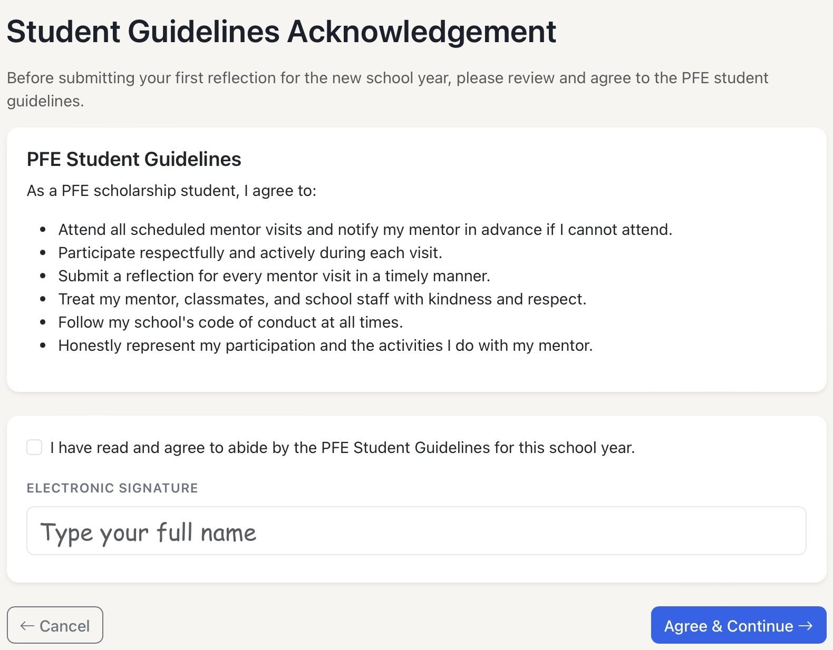
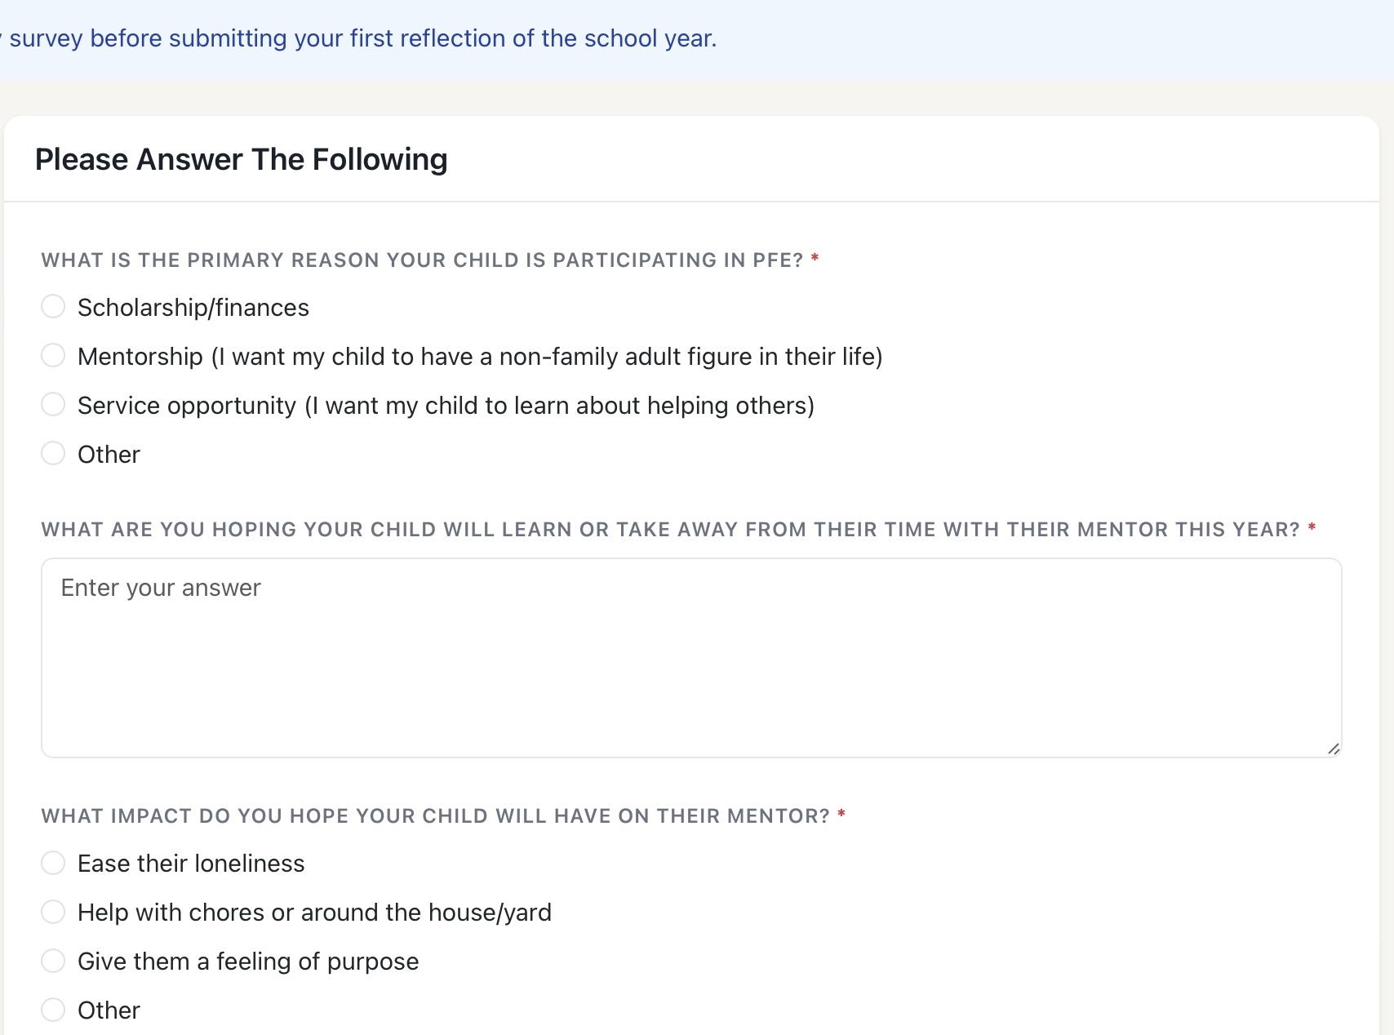
example of survey and guidelines

Slide 15
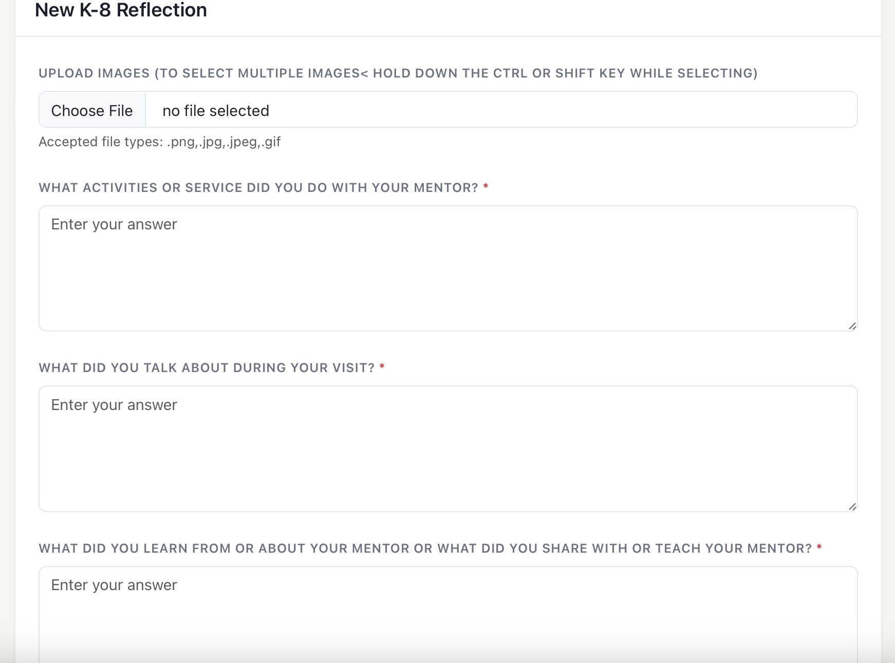
Reflection Forum

Slide 16
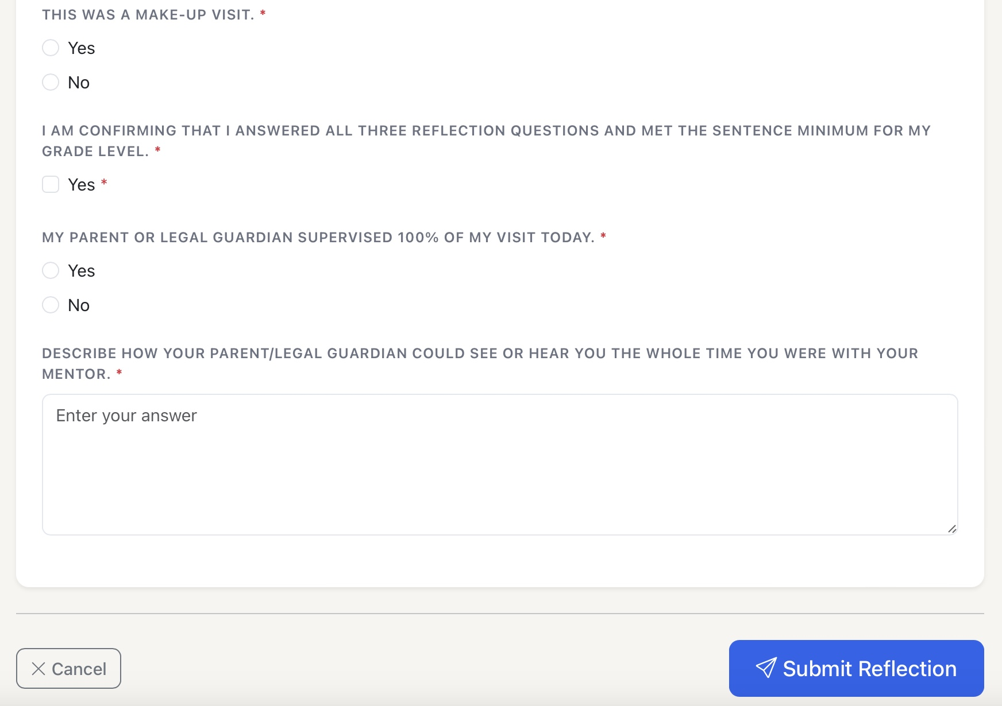
Reflection Forum

Slide 17
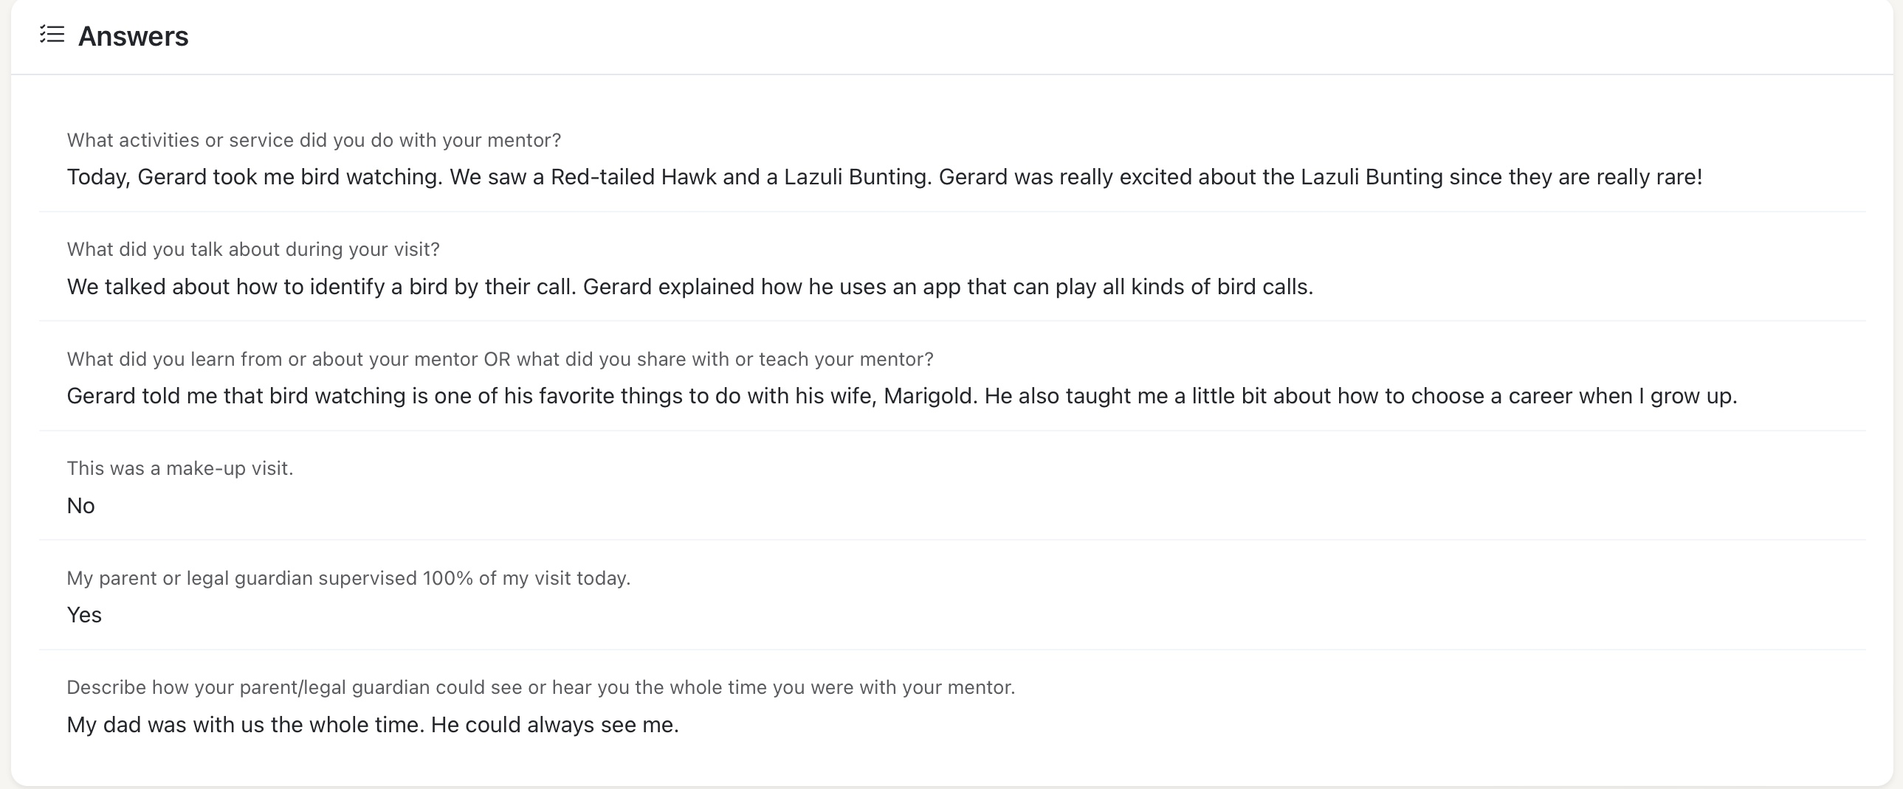
Good Example

Slide 18
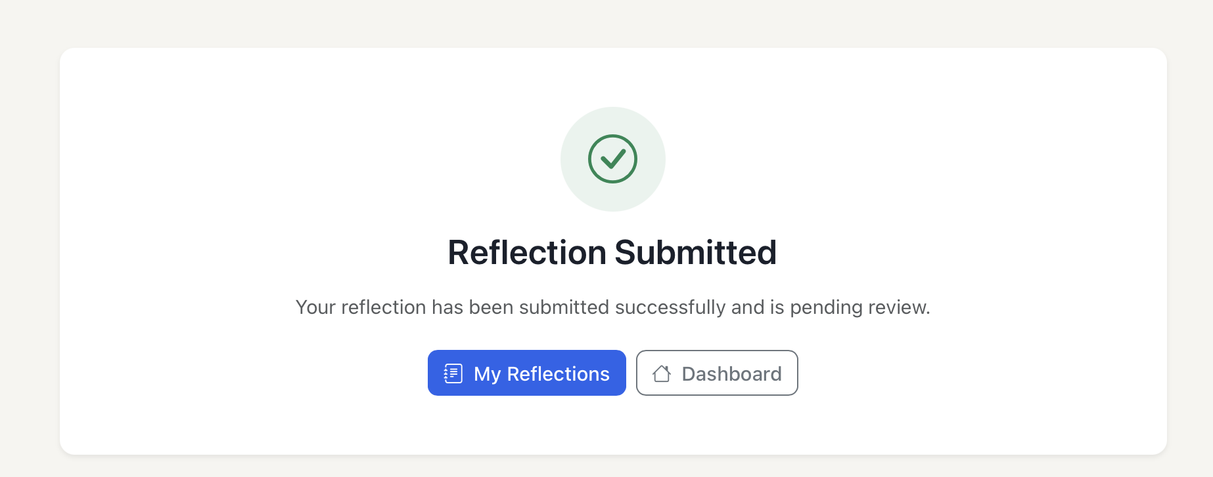
Reflection Submitted
You will receive an email (and text if you signed up for alerts) when a reflection is successfully submitted.
You will see this popup screen
Please check your dashboard also

Slide 19
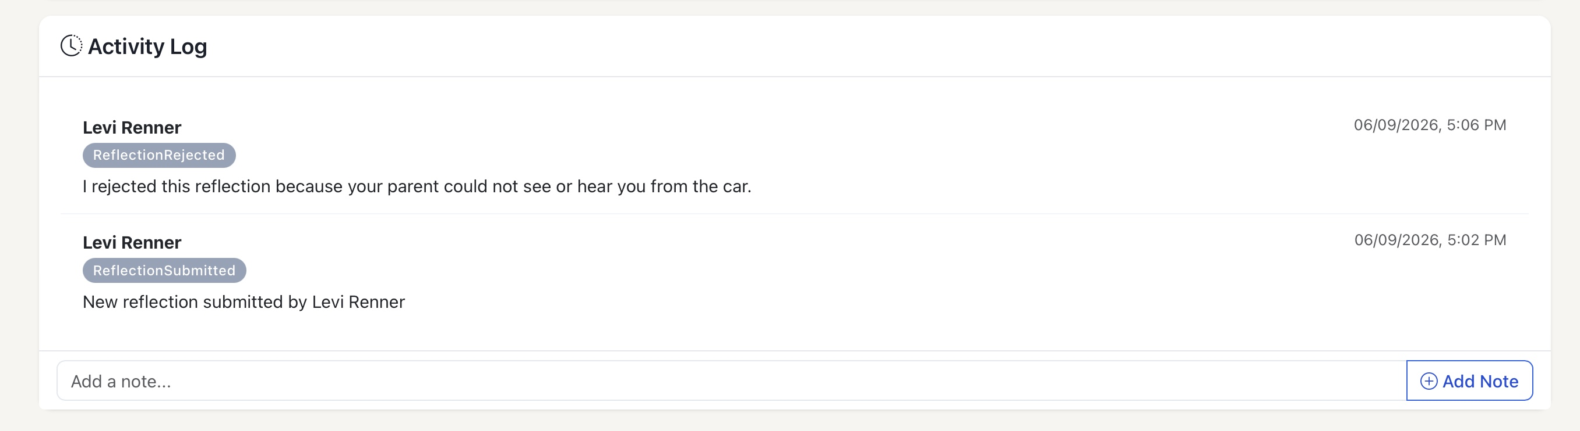
Activity log
Please check your activity log (bottom of the reflection page).
All activity pertaining to that reflection will be noted here.

Slide 20
Approval/Rejection/Resubmit
You will receive an email (text if opted) when a reflection status changes.
Approval-review Activity Log for notes from your coordinator
Rejection-review Activity Log for reason the reflection was rejected.
correct issue immediately
(if allowed)
resubmit reflection
(time sensitive-must be resubmitted within 4 days)

